Slide 1
Comprehensive Environmental
& Climate Action Plan
FY21-22 Work Plan
Environment & Sustainability
Task Force
August 27, 2021
Pharr Andrews & Katy Evans
Office of Environmental
Quality & Sustainability

Slide 2
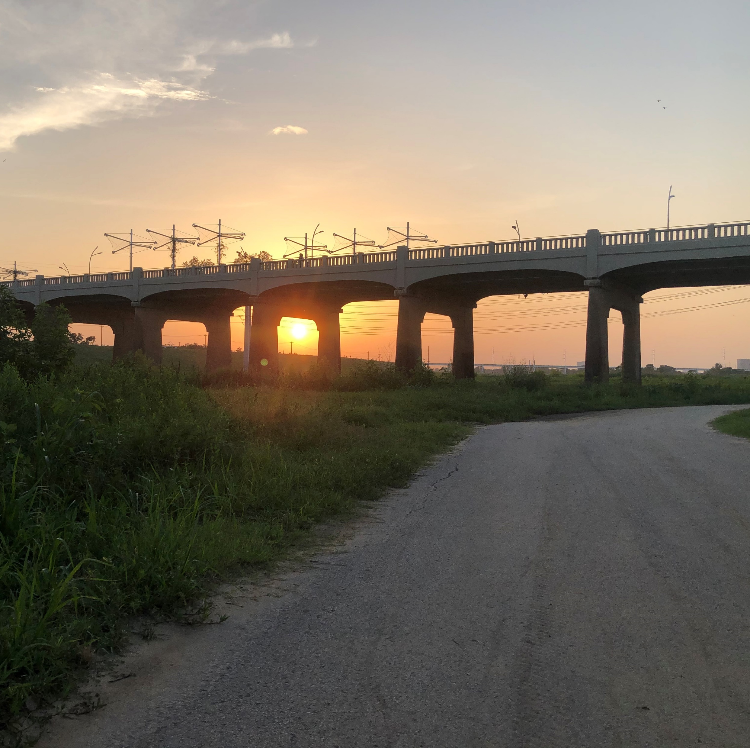
Overview
Introduction
Stakeholder Engagement
Actions and Activities
New Actions
Sector “Highlights”
Adaptive Management

Slide 3
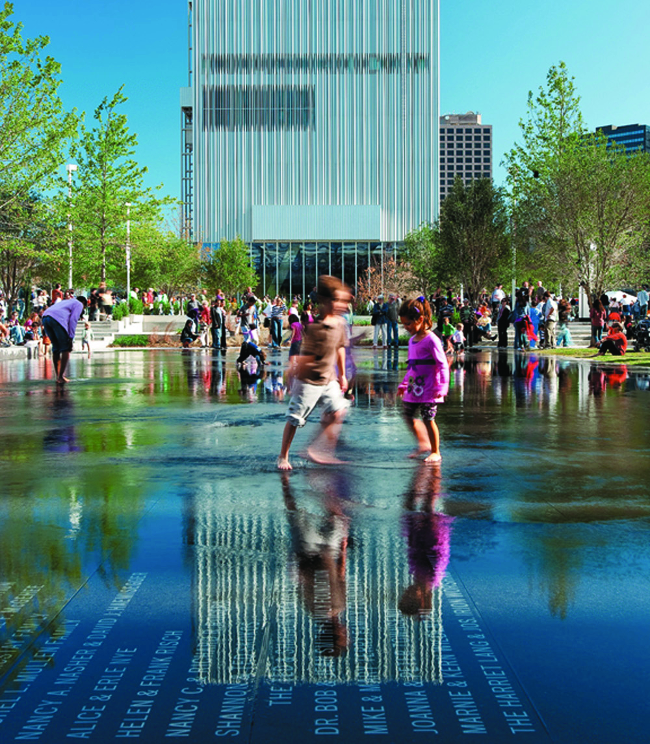
Focus Area
Building Capacity:
Education and outreach
Expanding partnerships
Amplify ongoing actions
Explore funding opportunities
Pilots and proof of concept projects
Tracking and accountability
Notes:
Year 2:
Extend Education efforts
Build on and expand partnerships
Extend concept projects
Improve tracking and accountability

Slide 4
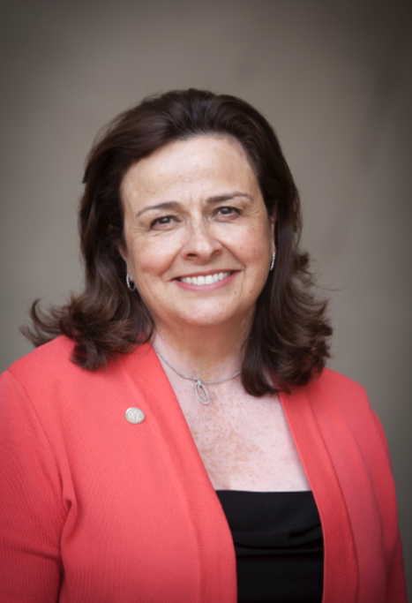
Environment & Sustainability Committee
Chair Paula Blackmon
Paul Ridley (Vice Chair)
Carolyn King Arnold
Adam Bazaldua
Jaime Resendez
Jaynie Schultz
Chad West
Charged with advising on CECAP implementation and other environmental/sustainability issues
Agenda coordinated by OEQS
Committee meets first Monday of the month at 9:00 AM
Notes:
We have tons of stake holders that not only add accountability but also contribute to our success…
WE are very luck to have such an active engaged committee of elected officials
The Mayor created a dedicated committee to shepherd the CECAP
5 elected officials meet monthly to review and provide input

Slide 5
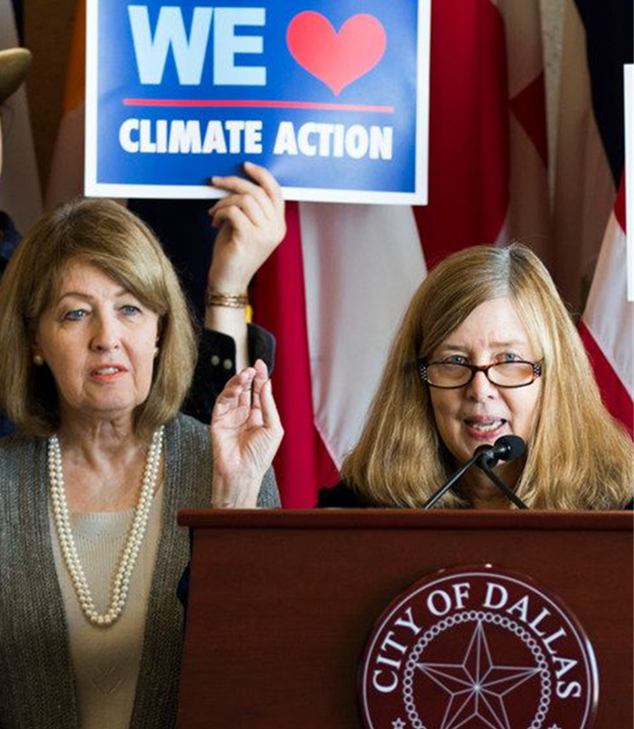
Environment & Sustainability Task Force
15 community members/ subject matter experts
Scope of Work:
Advise on environment, sustainability, and CECAP implementation
Develop the infrastructure and scope for a permanent commission, by City Ordinance
Notes:
We also have developed a path for the community of proved input into this plan….taskforce
They were assembled to specifically weigh in on CECAP and move to a more formal process

Slide 6
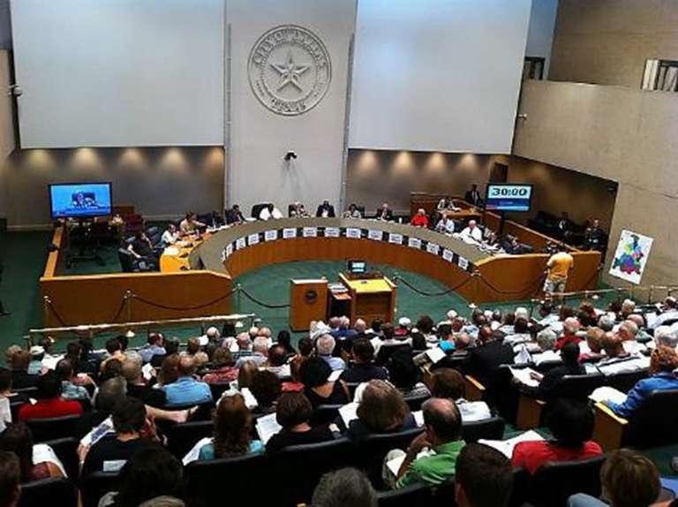
Environmental Commission
Established by City Ordinance on April 28, 2021
15 voting members
8 non-voting technical experts (one per CECAP Goal)
Monthly meetings, or as needed
Beginning October 2021
Standing Environmental Health Committee
Two-year appointments for members

Slide 7
The Regional Integration of Sustainability Efforts (RISE) Coalition, formerly the North Central Texas Stewardship Forum, works to engage interested local governments in peer-exchange opportunities to support sustainability and environmental initiatives.
Notes:
Our Regional Group of Sister Cities come together around Climate Action in a group called RISE
(another great acronym!)
Regional Integration of Sustainability Efforts
Align regional partner initiatives
Leverage regional resources and share best practices
Provide networking and capacity building opportunities
Identify funding opportunities for projects
Provide mentorship
Collaborate as a group on regional sustainability projects and initiatives​ ​

Slide 8
LEAF Stakeholder Group
Internal stakeholder group: Leading Environmental Action Forward (LEAF)
Participation is based on work plan commitments
Team: Staff from 19+ departments implementing CECAP actions and other related efforts
Meets and report quarterly
Reporting will shift to monthly in FY 21-22
Notes:
We are grateful for the efforts of staff from about 19 departments who are working together to implement the CECAP. We’ve developed a group that meets quarterly to coordinate on related efforts. I would note that we anticipate beginning the planning for next years implementation plan and milestones soon.

Slide 9
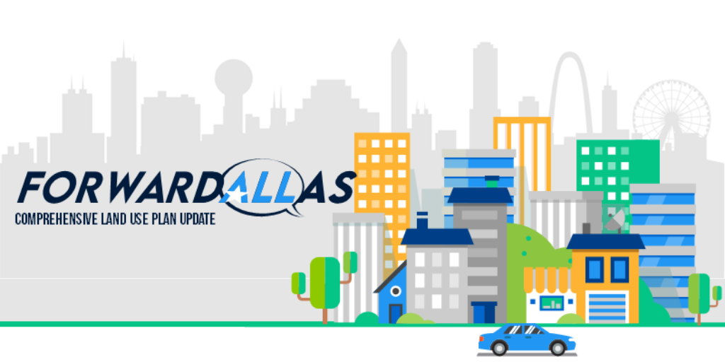
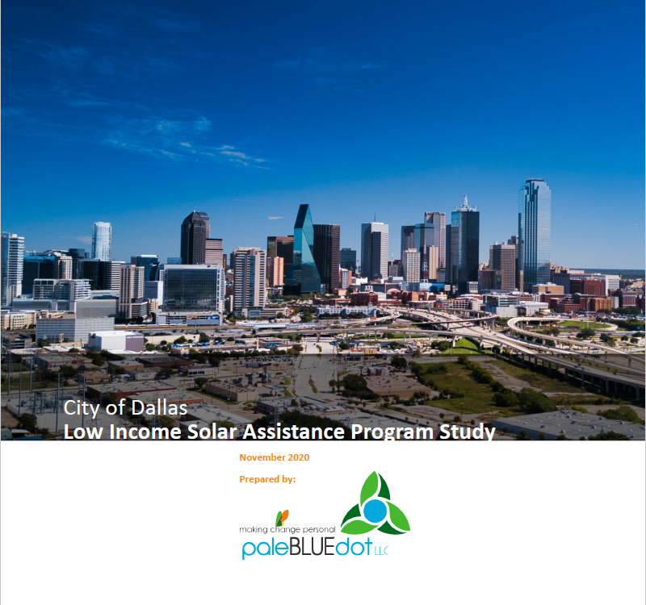
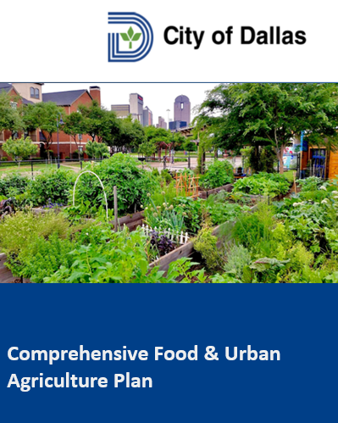
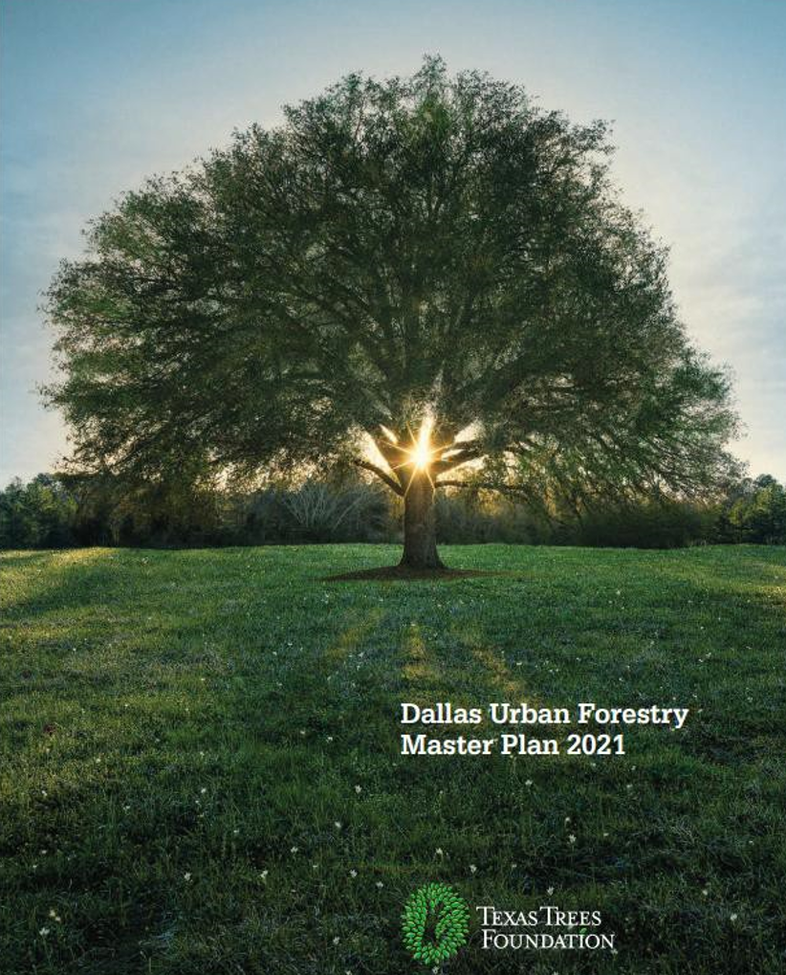
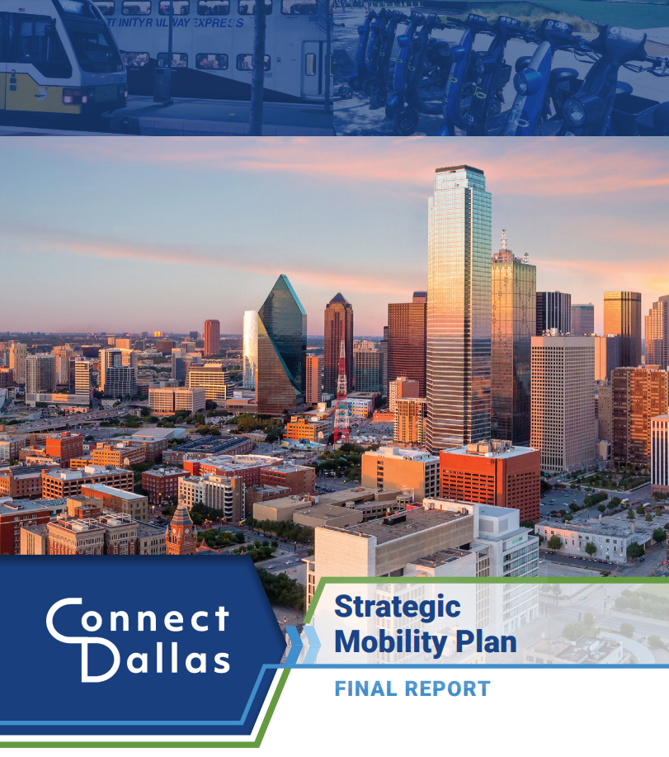
Notes:
Here is a look at a few of the plans we are aligning with CECAP (not a comprehensive list)…also Drainage Inventory and

Slide 10
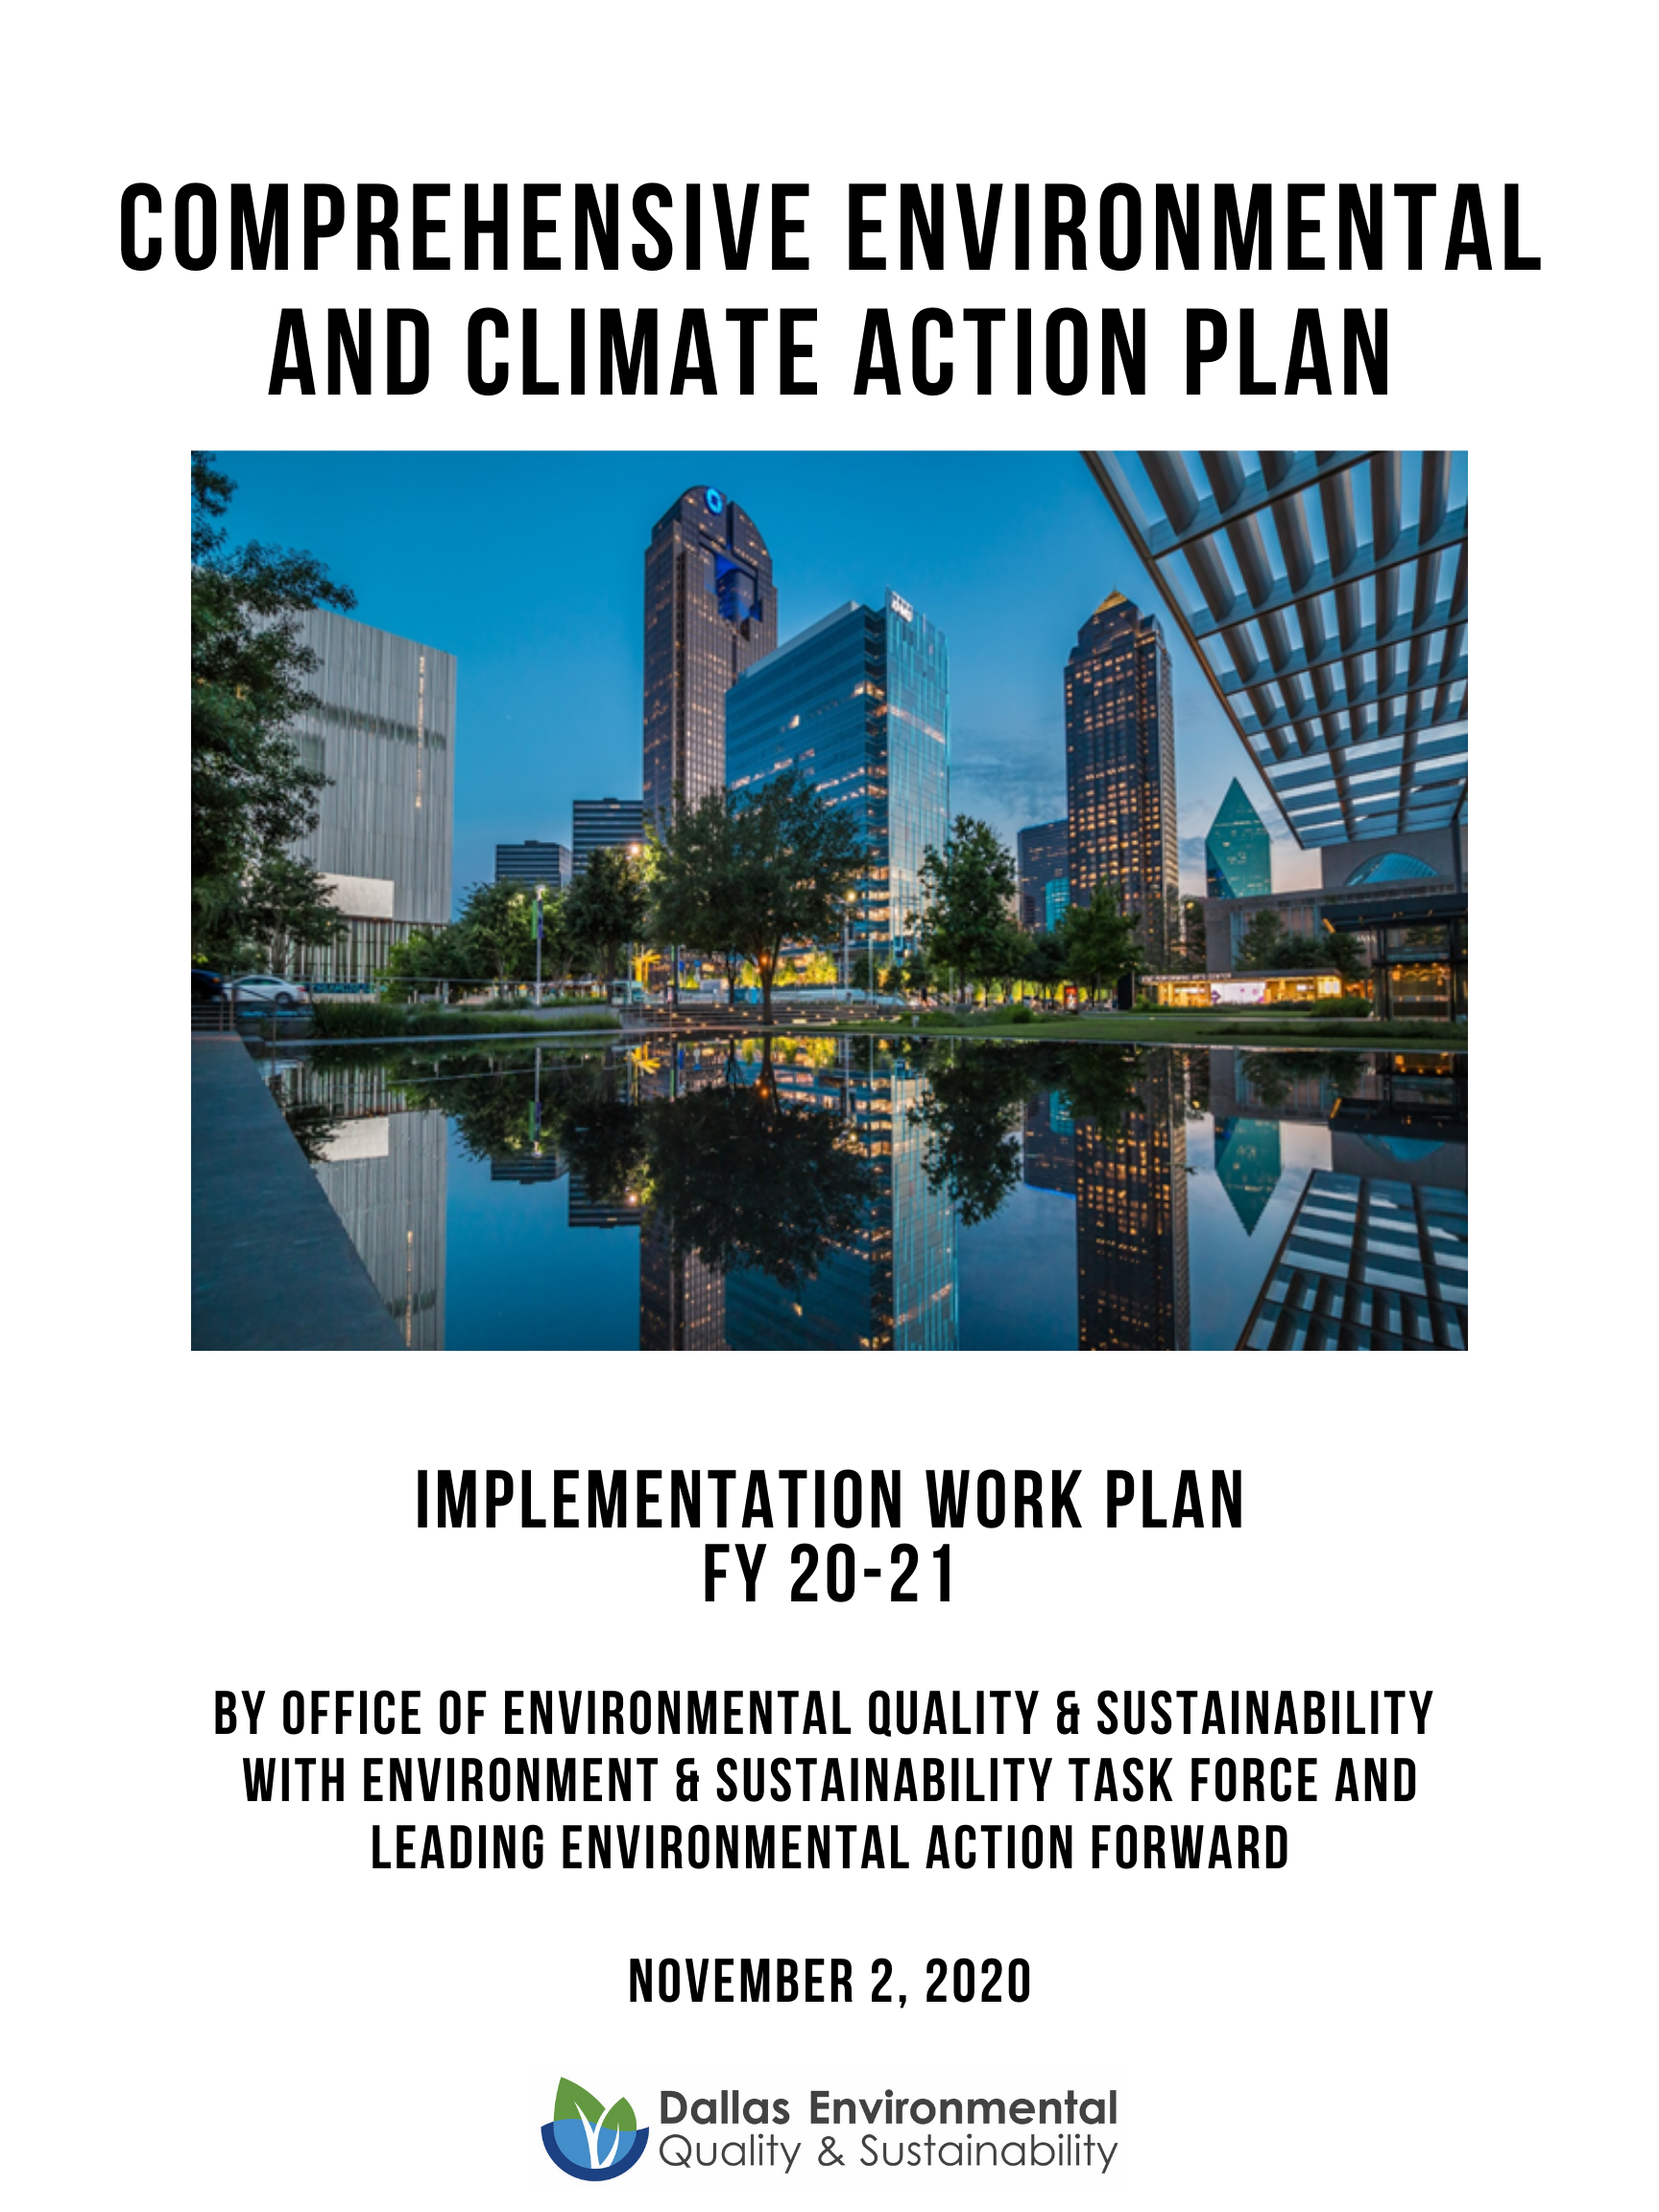
FY 20-21 Implementation Work Plan
Includes 48 CECAP actions that are divided up into 136 milestones for implementation and tracking purposes
Q3 Milestone Progress
Complete: 48%
In Progress: 50%
Not Started: 2%

Slide 11
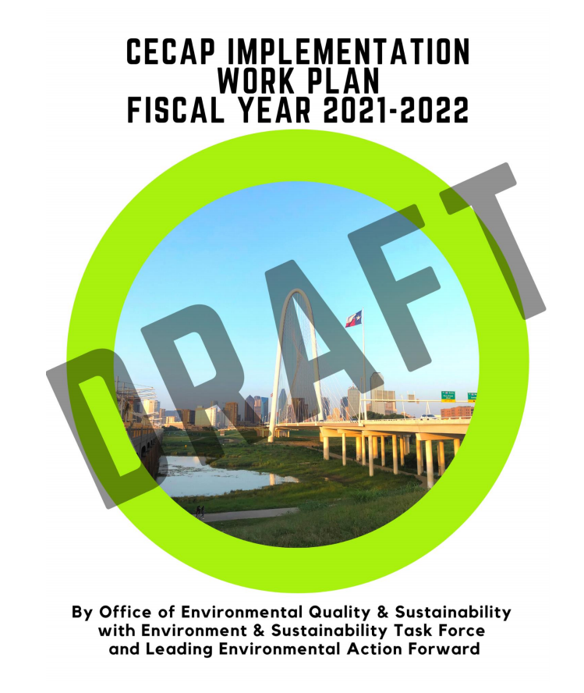
FY 21-22 Implementation Work Plan
30-year plan with 8 focus areas and 97 Actions
74 actions will be activated in FY21-22
27 new actions
263 Milestones
82 ongoing milestones
17 City Departments involved (and counting!)
Notes:
One of the things we learned from meeting with departments as we developed this plan is that there is a lot of CECAP related activity happening that we have not captured this year. We are also moving to dedicated milestones; each milestone will be assigned to one department. Therefore, where multiple departments may be working together on an effort, we may have multiple milestones associated with that effort. While this increases the overall number of milestones, it makes tracking and accountability a lot more straightforward.

Slide 12
Goal 1: Dallas buildings are energy efficient and climate resilient.
Total actions underway: 11 of 16
New actions activated in FY22 (5):
B3: Develop clear and comprehensive educational program for building owners and tenants about existing energy efficiency programs.
B4: Implement a citywide building weatherization program through partnership with community organizations.
B6: Establish a building efficiency and electrification program (for existing buildings) to replace appliances and systems with electric and other efficient and cost-effective options.
B13: Establish urban greening factor requirements for new developments that quantify how projects contribute to urban greening for reduced stormwater runoff and urban heat island improvements.
B14: Promote passive building design (e.g., orientation, shading devices) through the City’s zoning ordinance and design standards.
11 of 16
41 milestones by Aviation, Building Services, Housing, Economic Development, Development Services & OEQS (3 ongoing milestones)
Notes:
Items in green were specifically recommended by the Task Force; Energy efficiency education programs, weatherization, electrification, greening factor for new developments, and code updates

Slide 13
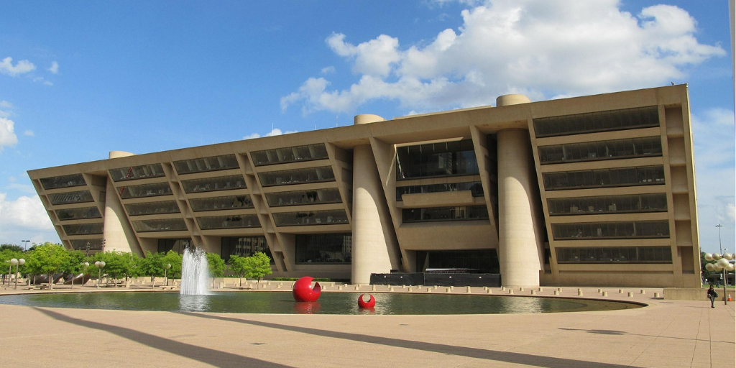
FY 21-22 Highlights: Buildings
City Initiatives
City Energy Management Program and efficiency upgrades
Net-zero specifications for future capital projects
Begin implementation of “resilience hubs” on City-owned properties
Outreach and Education
Energy efficiency education, including expansion of participation in PACE
Connect residents to weatherization programs
Code and Permitting
Building code amendments that support solar PV and EV charging
Evaluate SolarAPP+ for solar permitting
Notes:
Hit the highpoints

Slide 14
Goal 2: Dallas generates and uses renewable, reliable, and affordable energy.
9 of 11
Total actions underway: 9 of 11
New actions activated in FY22 (3):
E1: Maintain a high degree of reliability in the electric delivery grid through cooperative actions between the City and public utility companies.
E2: Evaluate the potential for the City to make investments in energy storage technologies for both resilience and renewable energy development purposes.
E4: Invest in programs through local community colleges to train and establish a local workforce that is focused on renewable energy technologies.
27 milestones by Bond & Construction Management, Building Services, Housing, Economic Development, Development Services & OEQS (5 ongoing milestones)

Slide 15
FY 21-22 Highlights: Energy
City Initiatives
Continue Green Energy Policy for City facilities
Continue to advocate for renewable energy policies and a resilient energy grid at state and federal levels
Feasibility studies for resilience hubs and renewable energy hubs
Solar
Work towards SolSmart designation
Continue community solar initiatives
Continue to require innovative renewable energy as part of the design services for City facilities in new construction or renovation of existing facilities
Outreach and Education
Continue renewable energy education
Encourage green workforce training
Notes:
These are some of the other energy-related actions underway this year – in particular, we have a contract on the street to put solar on the closed deepwood landfill, with a portion of the power generated set aside for lower income residents who would benefit from reduced power costs. We are also working with housing to solar on some of their affordable housing projects.

Slide 16
Goal 3: Dallas’ communities have access to sustainable, affordable transportation options.
13 of 19
Total actions underway: 13 of 19
New actions activated in FY22 (8):
T4: Establish a comprehensive incentives package to help accelerate electric vehicle use.
T8: Evaluate infrastructure to enable city policy on micro mobility services to be distributed equitably.
T9: Increase bus service across the city by adding new routes, shortening headways, and overall increasing service reliability and customer experience.
T10: Adopt a target corridor, district, or city-wide mode split goals to help reinforce policies aimed at reducing single-occupancy vehicle use.
T12: Expand upon the DART transit-oriented development (TOD) guidelines to collaborate on a new proactive TOD and housing strategy with DART.
T15: Implement green infrastructure programs that specify design and performance standards that treat the right-of-way as both a mobility and green infrastructure asset.
T19: Encourage businesses, commercial entities, and institutions to electrify fleet, including, but not limited to local and regional delivery trucks and other heavier vehicles.
27 milestones by Aviation, Bond Office, Convention Center, Fleet, Housing, Planning & Design, Dallas Water Utilities Transportation & OEQS (5 ongoing milestones)
Notes:
Lay language

Slide 17
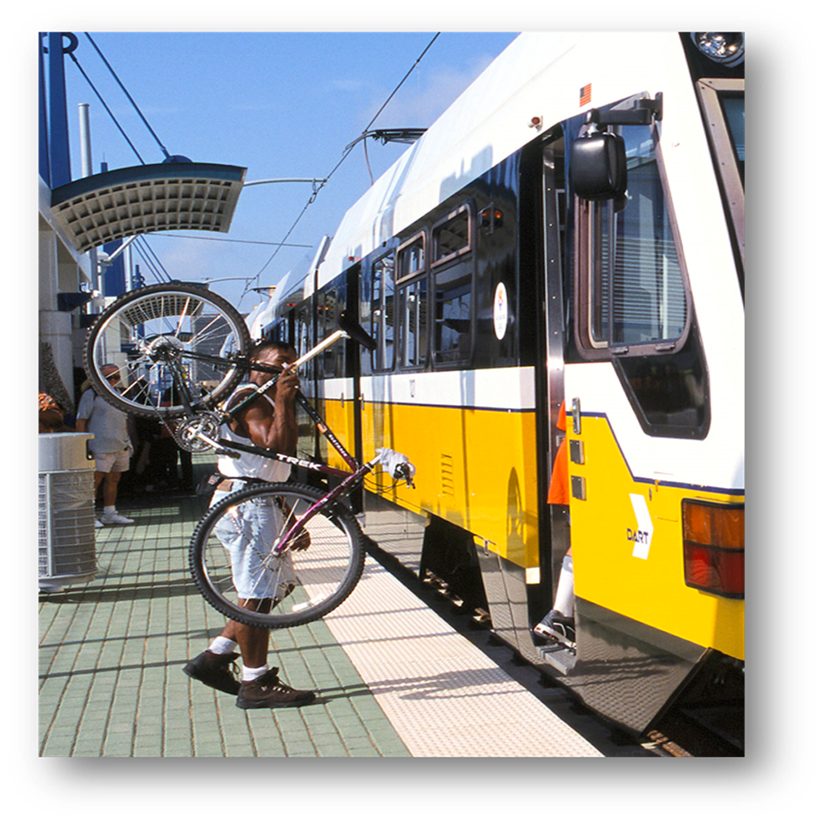
FY21-22 Highlights: Transportation
City Initiatives
Continue to align Forward Dallas with the Strategic Mobility Plan and CECAP goals
Continue fleet electrification with NREL
Update the 2011 Dallas Bike Plan and add 18+ bike lane miles
Continue to install publicly available EV charging stations
Reduce Single Occupant Vehicle Trips
Work towards NCTCOG 20% SOV reduction goals
Revise parking code amendment that supports mode-split goals and land use strategies
Notes:
These are some of the other opportunities we are working on this year.

Slide 18
Goal 4: Dallas is a zero waste community.
07 of 09
Total actions underway: 7 of 9
New actions activated in FY22 (2):
SW4: Explore potential for electric waste collection trucks.
SW6: Expand efforts to reduce illegal dumping by implementing recommendations identified in the “Litter and Illegal Dumping Assessment Study.”
22 milestones by Code Compliance, Convention Center, Procurement, Sanitation, Parks, & OEQS
(8 ongoing milestones)
Notes:
Lay language

Slide 19
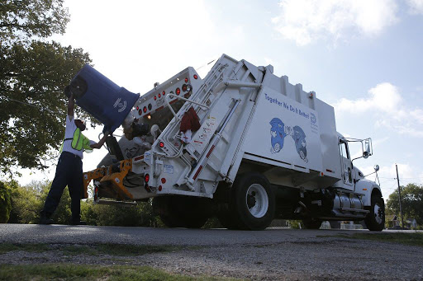
FY 21-22 Highlights: Zero Waste
City Initiatives
Complete Local Solid Waste Management Plan update
Begin comprehensive green procurement plan
Outreach and Education
Reduce illegal dumping
Community Trash Off events, BOPA collection
Landfill Diversion
Bulk and brush pilot (6 areas) to explore brush diversion
Compost pilot

Slide 20
Goal 5: Dallas protects its water resources and its communities from flooding and drought.
14 of 15
Total actions underway: 14 of 15
New actions activated in FY22 (3):
WR10: Evaluate policies affecting drainage and erosion to ensure sustainable development and mitigate adverse impacts.
WR13: Evaluate new technologies to lower nutrient releases into the Trinity Watershed from wastewater treatment plants and incorporate as appropriate.
WR14: Evaluate new or improved operational strategies and technologies to optimize the use of chemicals and reduce energy usage at water and wastewater treatment facilities.
58 milestones primarily by Dallas Water Utilities, with Convention Center, & OEQS
(24 ongoing milestones)
Notes:
Lay language

Slide 21
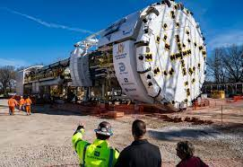
FY 21-22 Highlights: Water Resources
Outreach and Education
Continue all programs including water conservation, leak detection, water-wise landscaping
Continue local and regional awareness campaigns
Irrigation system evaluations
Infrastructure Resiliency
Continue implementing major drainage infrastructure projects
Initiate a Storm Drainage System Assessment and planning process
Continue implementing Drought Contingency Plan
Continue emergency planning to protect & maintain services of key water infrastructure in the event of extreme weather events
Water Quality
Continue water quality monitoring and protection
Continue monitoring for emerging contaminants

Slide 22
Goal 6: Dallas protects and enhances its ecosystems, trees, and green spaces that in turn improve public health.
7 of 9
Total actions underway: 7 of 9
New actions activated in FY22 (2):
EG1: Increase and improve access to green spaces particularly within vulnerable communities to reduce impact of urban heat island, localized flooding, and improve public health.
EG8: Improve the quality of urban ecosystems in Dallas through the sustainable appropriate design, creation, and planting of urban habitats.
52 milestones by Dallas Water Utilities, Convention Center, Development Services, Public Works, Planning & Urban Development, & OEQS (33 ongoing milestones)
Notes:
Lay language

Slide 23
FY21-22 Highlights: Ecosystems & Green Space
Green Infrastructure
Assess opportunities for blue-green infrastructure to reduce flood risks (Partnership with The Nature Conservancy)
Greening factor as part of parking code amendment
Nature-based solutions to address public health challenges (i.e., Cool Schools Program)
Outreach and Education
Continue to promote tree-planting efforts, protect trees & prairies, and promote drought-tolerant landscapes
Restore Branch-Out Dallas Program
Urban Forest Master Plan Implementation
Initiate Tree inventory
Initiate Emerald Ash Borer Plan
Identify and designate trees under Article X Historic Tree Status
City Initiatives
Update Parks O&M procedures to include eco-friendly practices
Notes:
Most of you will recognize the Urban Forest Master Plan from my last visit; this plan was adopted by City Council on June 7, 2021. Staff from Parks, DWU, Sustainable Development, Aviation, and Public Works have been working very hard to develop a public facing website to support this newly combined effort, in addition to the efforts with the Texas Forest Service related to the Emerald Ash Borer, an identified local pest. Most of the actions listed are either complete, or will be complete by the end of this fiscal year.

Slide 24
Goal 7: All Dallas’ communities have access to healthy, local food.
9 of 14
Total actions underway: 9 of 14
New actions activated in FY22 (4): FA4: Facilitate partnerships between schools and nonprofits to develop neighborhood-based growing initiatives and kitchen gardens in neighborhoods with low food access.
FA6: Partner with transportation organizations to identify creative transportation solutions to access healthy food retailers in neighborhoods with low food access.
FA7: Partner with supermarkets, food retailers and other supporting organizations to bring mobile grocery stores to neighborhoods with low food access.
FA13: Collaborate with organizations that are working to divert surplus food from grocery stores and markets to reach communities in need.
26 milestones by Economic Development, Convention Center, Procurement, & OEQS
(4 ongoing milestones)
Notes:
Lay language

Slide 25
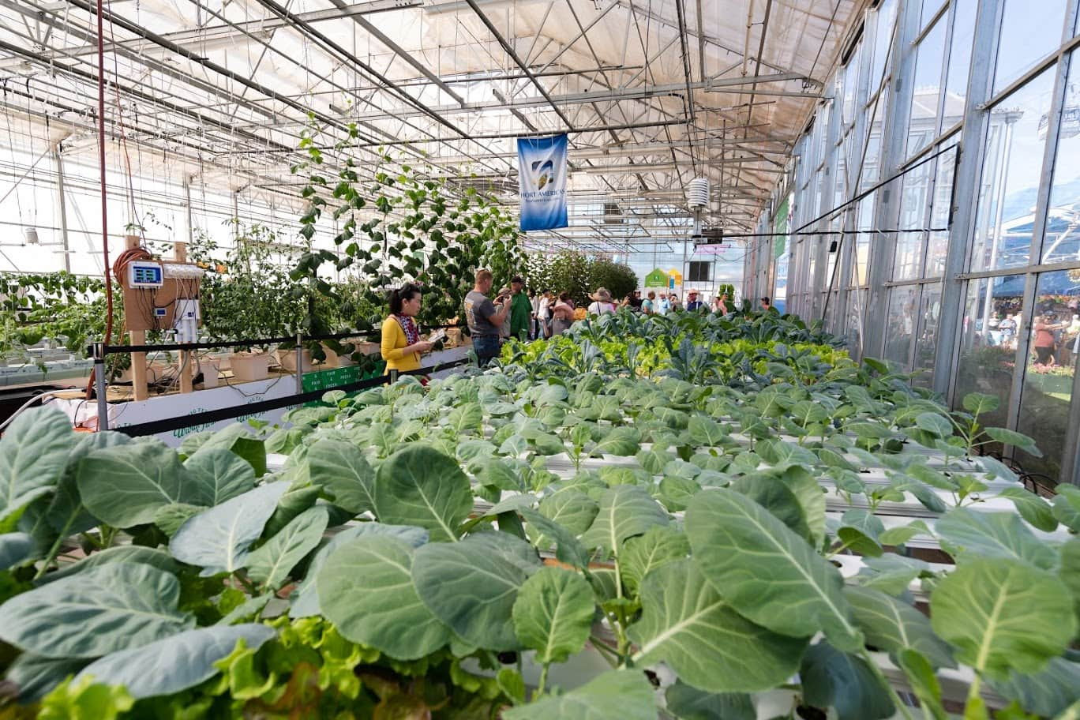
FY 21-22 Highlights: Food/Urban Agriculture
Urban Agriculture Plan
Implement Food Advisory Council
Continue work on Food & Urban Agriculture Plan
Evaluate and develop a plan to remove barriers to growing local food for personal consumption or economic development
Outreach and Education
Provide information on local healthy food
Food Security
Continue Supporting Healthy Dallas Food Initiative
Support existing systems related to transportation and food access
Develop Food Waste Pilot Program

Slide 26
Goal 8: All Dallas’ communities breathe clean air.
4 of 4
Total actions underway: 4 of 4
New actions activated in FY22: 0
All Air Quality actions have been activated
10 milestones by Planning & Design, Transportation & OEQS
(5 ongoing milestones)
Notes:
Lay language

Slide 27
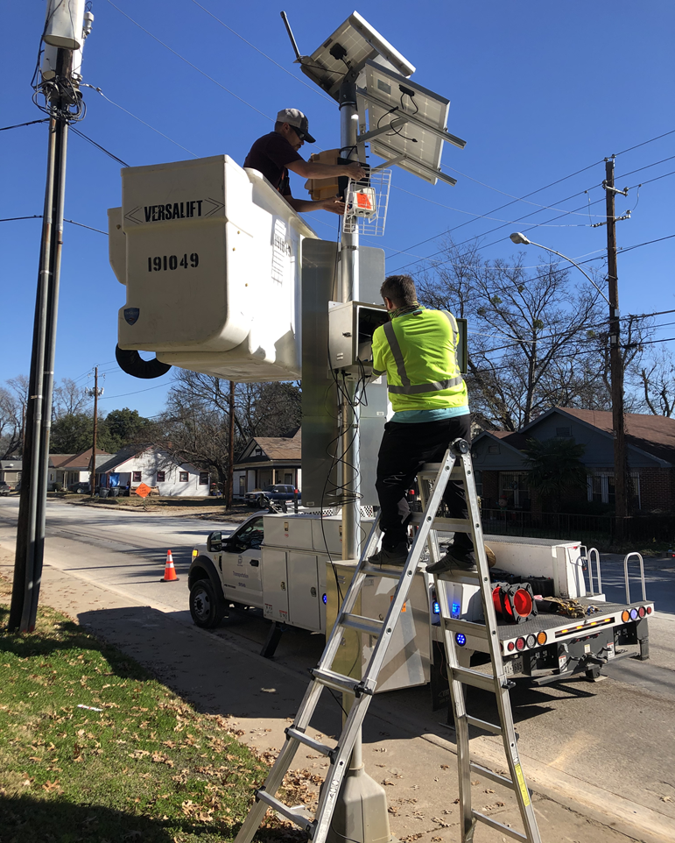
FY 21-22 Highlights: Air Quality
Outreach and Education
Continue to support NCTCOG Air North Texas Program and Clean Air Action Day
Regulatory Air Monitoring
Work with TCEQ to expand network
Non-Regulatory Air Monitoring
Expand network by implementing 2 grant programs
Build data platform
Environmental Justice
Work to expand strategies to address situations with inequitable industrial proximity to residential land use
Air Quality monitor installation at Exline Recreation Center

Slide 28
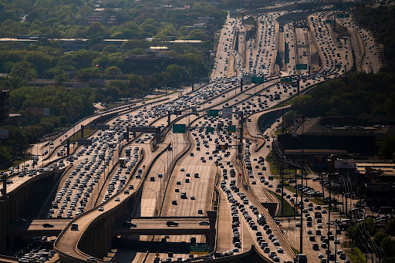
Adaptive Management
The GHG inventory will be updated every 3 years and will be a key indicator of the success of CECAP.
OEQS climate staff has begun updating the greenhouse gas (GHG) inventory using data from 2019.
This will allow an assessment of where the City currently stands, guide future planning, and identify any necessary CECAP plan updates.
Photo Credit: Dallas Morning News
Notes:
Continual improvement

Slide 29
Performance Measure: 92% FY Milestones Implemented
Notes:
So – If you’ve like to see how we’re doing on all this – you can find us on the Dallas 365 Dashboard…. Also – the goals is for 92 percent of the milestones identified for this year, - not the whole plan! It is a 30-year plan.

Slide 30
CECAP Performance Dashboard
Detailed tracking at DallasClimateAction.com
Notes:
Or, you can find more detailed information on plan background and status at DallasCLimateAction.com = there is a place to sign up for updates there as well.

Slide 31
Comprehensive Environmental
& Climate Action Plan
FY21-22 Work Plan
Environment & Sustainability
Task Force
August 27, 2021
Pharr Andrews & Katy Evans
Office of Environmental
Quality & Sustainability

